Slide 1
Distance measuring with LEDs
Faculty : Electornics, Telecommunications and Information Technology
Students : Veliciu Vlad
Pop Emanuel

Slide 2
Project components
In order to build this project we used several electronic components and devices:
resistors;
LEDs;
ultrasonic sensor;
Arduino board.
breadboard
jumper wires

Slide 3
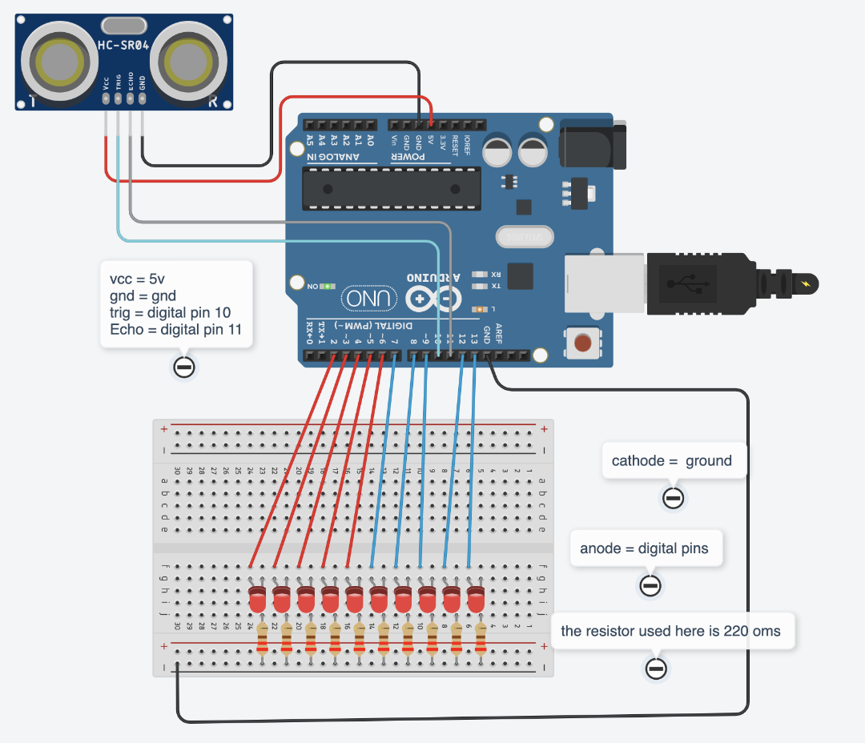

Slide 4
Explaining the code
The code was written in C/C++ language, it is quite simple and it provides the following functionality of the project.
if the reference point is very close to the sensor ( > 10 cm ), the first red led will turn on, being followed up by the other red leds as the distance increases.
as the reference point is moving away from the sensor, the other leds will turn on in the following order : yellow, green and blue.
the minimum distance required for all the leds to be turned on, has to be 100 cm.

Slide 5
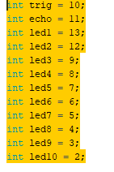
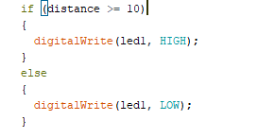

Slide 6
Project’s application
The project we made, could fulfill the functionality of:
car parking sensors.
security systems.

Slide 7
